Slide 1

Machine learning

Slide 2
What IS MACHINE LEARNING?
Set of methods that can automatically detect pattern in data and then use the uncovered patterns to predict future data or to perform other kinds of decision making under uncertainty
Machine Learning is a form of Artificial Intelligence in which the program is designed to learn on its own.

Slide 3
TYPES OF MACHINE LEARNING
Predictive/Supervised Learning
Descriptive/Unsupervised Learning
Reinforcement Learning

Slide 4
Supervised machine learning
Predictive/Supervised Learning
Goal is to map inputs to outputs given a set of labeled input-output pairs
All data is labeled (has categories)
Classification and Linear Regression are two approaches under this type of machine learning
Eventually, you want to make a prediction of an output given an input

Slide 5
Unsupervised machine learning
Descriptive/Unsupervised Learning
Goal is to find interesting patterns in a given data set.
All data is unlabeled.
Association, Anomaly Detection

Slide 6
REINFORCEMENT Machine LEARNING
System learns how to act/behave in a particular fashion (do its job) based on its previous experiences with doing a similar type of job in the past (works via human feedback)
Example - Playing Video Games

Slide 7
Machine learning Used on earth
Image Classification & Handwriting Recognition (MNIST)
Facial Recognition
Google’s “SmartAssistant” predicts probability you click on an ad based on your search history and other user ad – specific features
Product Recommendations on Amazon, YouTube, Facebook, Reddit, etc
Uber’s pricing for fare rides & ETA
Google Translate and Google Maps
Fraud Detection
Medical Diagnosis

Slide 8
Neural Network
Is a series of algorithms/computer processes that is used to recognize relationships in a set of data
Believed to be inspired by the way the human brain operates
Involves nodes and has 3 types of layers – input, hidden, and output
Subset of Deep Learning, which is a subset of Machine Learning that uses multiple layers to progressively extract higher level features from the raw input
Has weights and biases
Weights determine the strength of the relationship between 2 nodes
Bias is how far off are the predictions from the real values

Slide 9
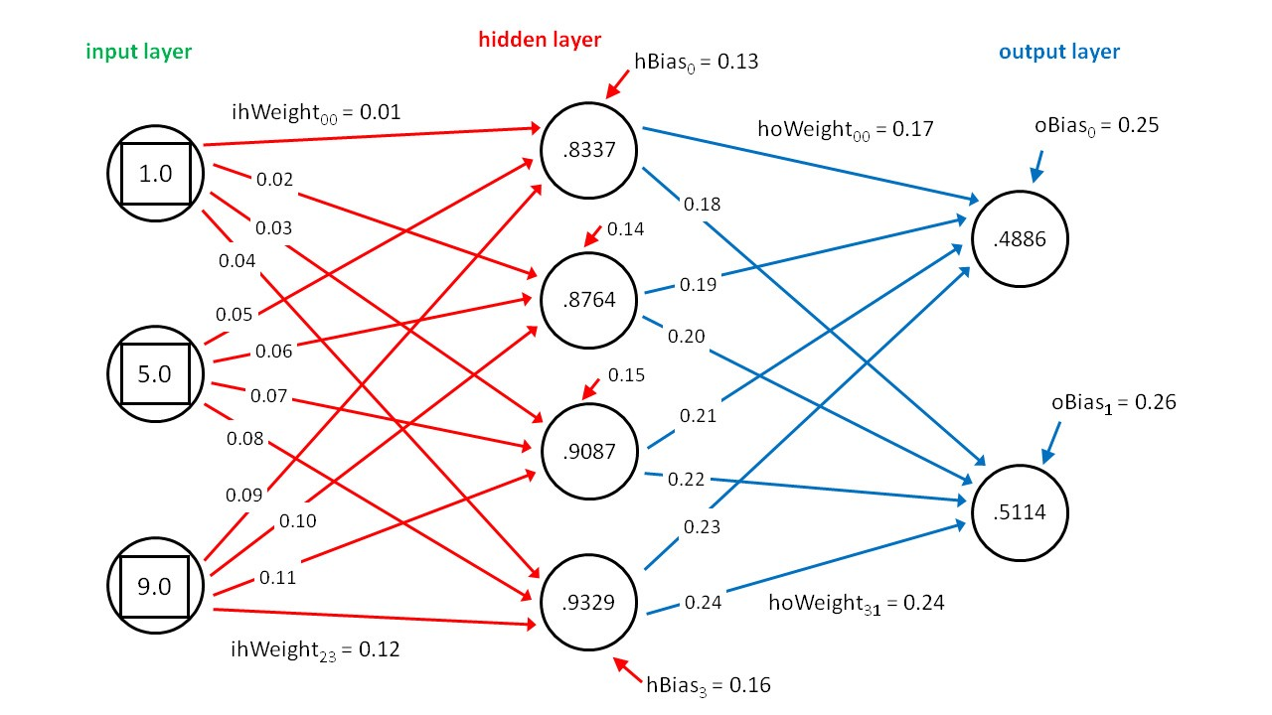

Slide 10
Sigmoid Functions
Type of activation function for the nodes/neuros
Analog and differentiable in binary depending whether it meets threshold or not

Slide 11
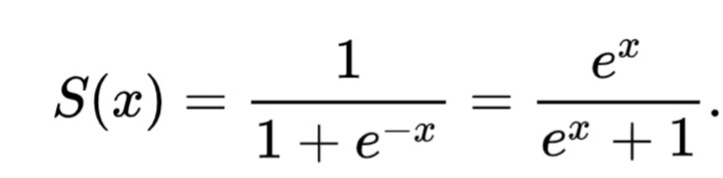

Slide 12
